Slide 1
Road Safety , post crash response and it’s cultural dimension
Eric Remacle

Slide 2
Culture?
Culture can be considered as a wider form of social norm – with it’s relation with gender, nationality, social network, academic background, …and identity
Culture is evolving phenomena
Culture will influence behaviours

Slide 3
Pillar 1 :Road safety management
Culture Culture(s) will influence :
Social norms (laws)
Political norms ( form of gorvernments)
Decision making process

Slide 4
Pillar 2 : Safer Roads and mobility
Culture(s) will influence :
Urban planning as cities will grow based on social dynamics ( water, churches, …)
Place of vehicules within cities
Importance of universal accesibility

Slide 5
Pillar 3: Safer vehicules
Culture(s) will influence :
Choice of vehicule based on identity
Choice of vehicule based on wealth and social prestige

Slide 6
Pillar 4: Safer Users
Culture(s) will influence :
Risks perceptions / behaviours
Enforcement practices ( corruption, selective enforcement, …)

Slide 7
Understand behaviours will help us to influence risky behaviours
5 keys factors to consider :
Attitude
Subjective norms
Perceived behavioural control
Emotions / affect
Past behaviour ( resistance to change)

Slide 8
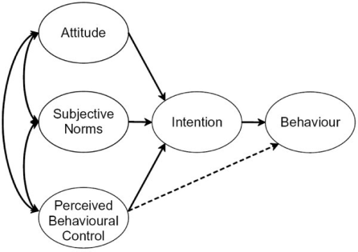
Theory of planned behaviour (Ajzen)

Slide 9
Pillar 5: Post crash care
HEALTH
Culture(s) will influence :
First aid at the scene of the crashes :
Gender perspectives
Perception of the other’s body : blood and spirits
Perception of help : individualism, community and debts

Slide 10
Pillar 5: Post crash response
HEALTH
Culture(s) will influence :
Psychological support :
Providers : community groups, self help groups, familly members, religious or spiritual leader, professional, …
Perception of death/grief /mourning process

Slide 11
Post crash response
Culture(s) will influence :
JUSTICE
Culture(s) will influence :
Interpretation of the event : factual and spiritual – from « responsible » to « tool of destiny »
Status of victims and offenders : bhrama and dalit
Access to various forms of legal systems
Process of negociation and access to compensation

Slide 12
Post crash response
SOCIAL INCLUSION
Culture(s) will influence :
Perception on / and attitudes toward disability, …
Access to IGA /Education
Community engagement : victims and advocates
Willigness to share experience/ testimonies

Slide 13
What’s HI doing ?
Handicap International is active in improving first aid and ambulance services for crash victims and develops actions to improve the capacity of local stakeholders . The aim is to deliver first aid to road crash casualties, refer them to appropriate health facilities and rehabilitation services. Handicap International promotes referral to psychosocial support and basic rehabilitation (including AD) services as an extension of the immediate response.

Slide 14
What’s HI doing regarding PCR ?
Support Victims of road traffic crashes.
Organising Self help group support
Institutional support
Strategic support
Technical support
Financial support for road safety intervention

Slide 15
What’s HI doing ?

Slide 16
Thank you !

