Slide 1
“Working to protect the interests of road crash victims & to reduce road danger”

Slide 2
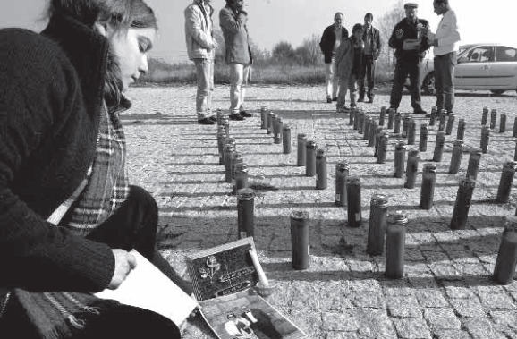
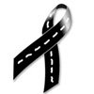
WHY Victim organisations?
The steep rise in road traffic injuries 70’s
Victims were left completely neglected
and without assistance or help.
victims suffered twice when the legal process offered no real justice.
Very few governments have committed themselves during the 25 years of FEVR existence to improve the situation of victims and also have largely failed to enforce road traffic laws in a sustainable way.
Victim organisations have been moved to fill the void left by government failures.

Slide 3
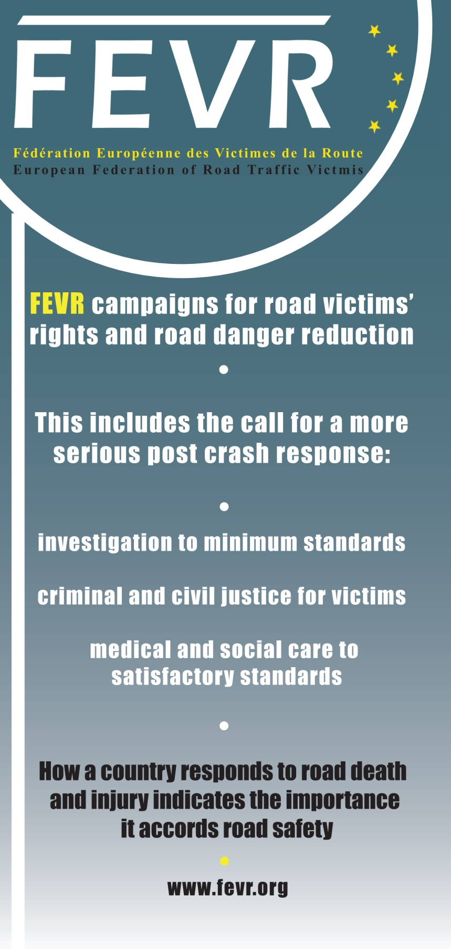
The Basic needs of trauma victims are:
-instant full and accurate information
- upholding of their human rights and respectful treatment
- acknowledgement of their loss and suffering by society, government and the judicial system
Notes:
Besides work to prevent road crashes, a proper post crash response (Pillar 5 DoA ) is essential - it is interdependent with prevention. The post crash stage is at present being neglected, it is our – the road victims’- role to bring an end to this neglect.
The Road Safety Strategy of each Member State must never leave out the `Post Crash response` - Investigation, Prosecution, and Support Services for Road Crash Victims.
A serious response to road death and injury and decent treatment of road victims are seen by FEVR as road victims’ human rights.
include accurate information, trauma care, rehabilitation, an appropriate legal response, as well as funding for organisations providing support to victims
“How a country responds to road death & Injury indicates the importance it accords to road safety”

Slide 4
FEVR Areas of activities
Support services
Road victims’ human rights
Trauma care
Rehabilitation
Appropriate legal response
Funding for organizations providing support to victims
FEVR as an Advocacy Organization for road crash victims
Laws that are consistently applied, so that they also act as a deterrent.
Access to justice
Addressing pedestrian rights
Speeding
Decrease of the power of cars
The offences of hit and run
Alcohol & drug use
Distracted driving and Phone use
Reduction in the consequences of crashes
Reduction of CO2 emissions
Road Danger Reduction
Notes:
Support services
Road victims’ human rights, trauma care, rehabilitation, appropriate legal response, funding for organizations providing support to victims…
Access to justice
As an Advocacy Organisation for road crash victims, FEVR wants to see the difference in the treatment of road crash victims where the law had been broken, compared with other victims of crime or culpable acts, reduced to a minimum and wants to see in operation just laws that are consistently applied, so that they also act as a deterrent.
Road Danger Reduction
Addressing pedestrian rights, speeding, decrease of the power of cars, the offences of hit and run, alcohol & drug use, phone use, tailgating etc., while also seeking a reduction in the consequences of crashes as well as of CO₂ emissions.

Slide 5
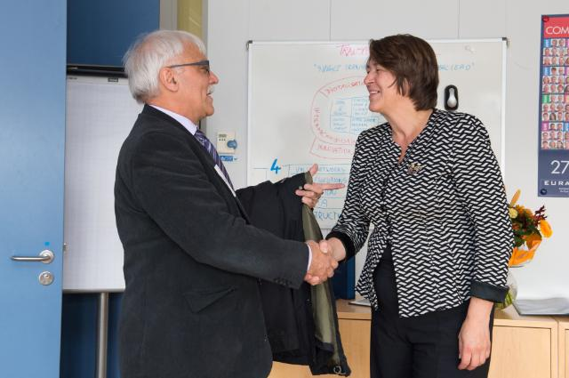
FEVR Areas of activities
More serious post crash response:
→ Investigation of crashes to minimum standards and MDCI = Multi Disciplinary Crash Investigation
→ Criminal justice - with appropriate laws, charges and sentences
Civil justice – length of proceedings to be reasonable and damages payments to be fair
Strict liability law
→ Medical care – both physical and psychological to satisfactory national standards
Notes:
Civil compensation
If injured in a crash whilst walking or cycling, do children, elderly and those with disabilities always qualify for compensation?

Slide 6
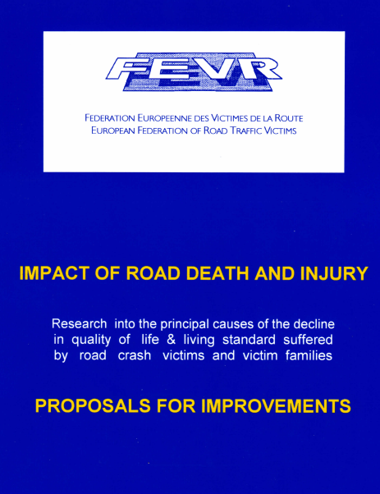
Studies
Dissatisfaction with criminal and civil justice
No legal recognition head injury impairment

Slide 7
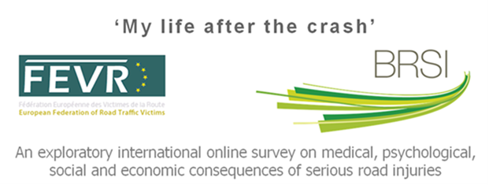
Insurance claims (and criminal justice proceedings, if applied)
Understand how victims could be better supported

Slide 8
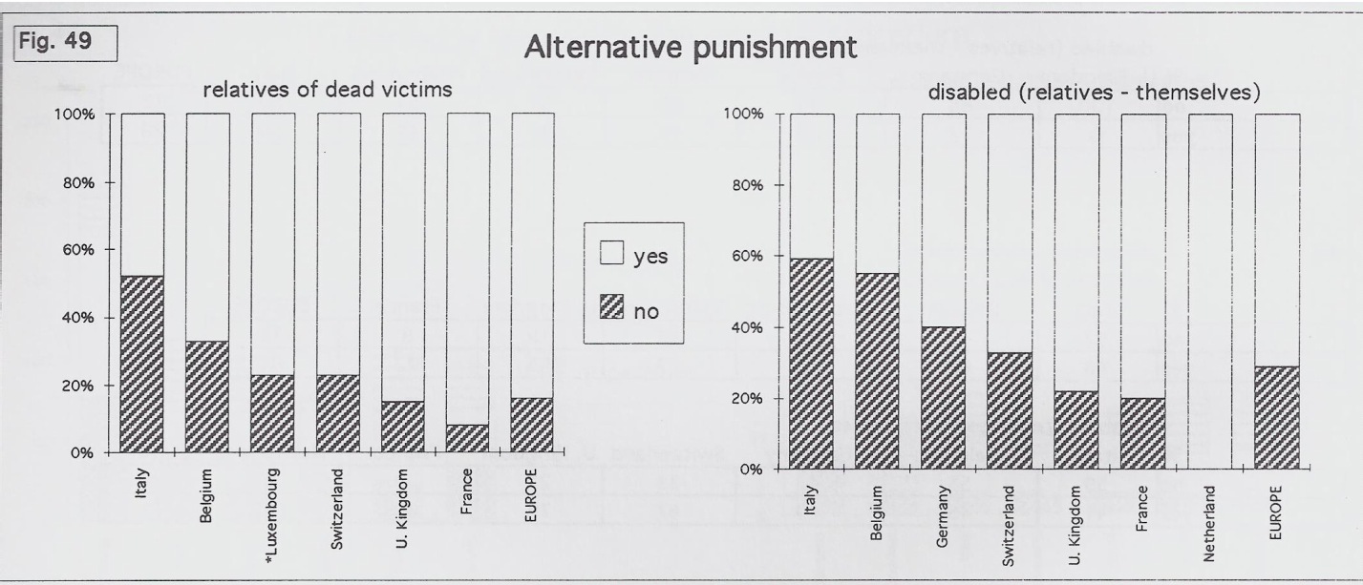
Victim of Traffic Offences
Gaining recognition victims of road traffic offences
Preventing secondary victimisation
Improving effectiveness and accessibility of support
Facilitating multidisciplinary cooperation
Restorative Justice

Slide 9
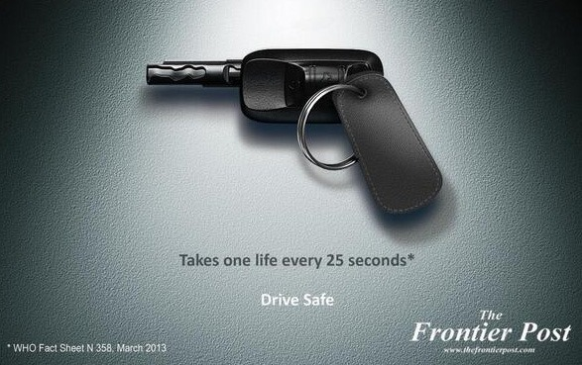
Victims of Crime & Violence Treat certain violations as premeditated criminal offences Do those killed and injured by law breaking on the road treated have the same rights to information and support as victims of crime?

Slide 10
Report by FUNDACION MAPFRE/FICVI : “Response after traffic “accidents” in Ibero-American countries
• Guide for victims and units (centres) of assistance
• Specialist road traffic crime prosecutors
• Victims’ Law
Notes:
Legal • Legislation must be written so that the laws clearly express the risks involved in certain kinds of behavior while driving, specifying in the criminal code, for example, the blood alcohol levels and speed limits allowed and those considered as a crime or an offense. • Road Safety Prosecutor’s Offices should be created to protect the rights of victims. • Legislation must be written to establish preventive checks for blood alcohol levels and speed limits by installing speed cameras and deploying police officers to fine the offender. • The legal system should be preventive for society, healing for the victims, and re-educate the offender. • There is a great deal of legislation on these issues but only rarely is it applied, creating occasional feelings of helplessness and distrust of the legal system.

Slide 11
NGO Brussels Declaration (May 2009)
Recommendations on:
• Collision investigations and importance to prevention
• Civil compensation for vulnerable road users (Strict/Presumed liability)
• Proportionate and deterrent legal response (criminal prosecution)

Slide 12
Justice and Post-Crash Response concept note ( Brasilia Nov. 2016 )
Road deaths to be professionally investigated (as homicide), with the bereaved treated as victims of crime, until the contrary is proven.
• End the complacency within the justice system towards driving offences. Road crime should be treated like other crimes
Notes:
Road traffic law --correct criminal charges? How can road traffic law help deter bad driving? What should the charges be and the penalties? Road traffic law is a complex area. It includes specific offences such as drink driving but also general driving offences covering careless and minor negligence but also reckless and dangerous behavior.

Slide 13
“Our Federation and its national Associations defend the right to life without compromise.“
Marcel Haegi, 2002 FEVR founder and 1. president
As an Advocacy Organisation for road crash victims, FEVR wants to see an end to the discrimination of road crash victims, compared to other victims of crime or culpable acts, and wants to see laws that deter and are consistently applied.
Brigitte Chaudhry
FEVR 2. president

Slide 14
FEVR Strategy 2016-2020
Objective 3: Post Crash Response
Ensure that the post-crash response is included in road safety strategies and programs and that the health and justice system is not forgotten.
Raise awareness of importance and need for improvement of collision investigation and criminal prosecution, and promote good practice. Encourage a thorough investigation into the crash and the application of an effective legal response to road deaths and injuries and therefore encourage fair settlements and justice for the bereaved and injuries.
Notes:
Presented the Strategy GM September 2016 in Lisbon
Developing the 3 ½ year action plan (November 2016- Mai 2020)
Annual review at each annual General Assembly in September
Midterm review in June 2018 (Barcelona)
Final Evaluation 11 Mai 2020 ( end of DoA)
Monitoring and evaluation

Slide 15
Crash or Collision is no Accident
Notes:
Those who have been bereaved or severely injured by a reckless driver do not want to hear the incident being described in the same terms as a milk spillage.
Crashes have causes and contributory factors, accidents have excuses. Using ‘accident’ encourages a sense of fatalism, with fewer resources invested in prevention efforts as a result.

Slide 16
